Slide 1
Continuity and Innovation in the Liability Rules: How the DSA faces the Platform Liability’ Quandary
Teresa Rodríguez de las Heras Ballell
Professor of Commercial Law, Universidad Carlos III de Madrid
Academic Visitor, University of Cambridge
Member of the Expert Group to the EU Commission Observatory on Platform Economy
teresa.rodriguezdelasheras@uc3m.es

Slide 2
Digital Economy is today a Platform Economy

Slide 3
Responsibility: Recommendations and Communication
2000
2020+
ECD
DSA
DMA
Irregular transposition
Sectoral Rules
ECJ decisions
Copyright Directive art. 17
Audio-Visual Directive
P2B Regulation

Slide 4
Key Issues to Consider for Harmonized Platform-Centered Rules
1). Legal concept of Platform – hosting services
A). General concept based on a functional approach and service-based
B). Concept beyond “intermediary service providers” (ECD): dissemination (unlimited)
C). Purpose-specific concepts/definitions - online content-sharing (DSM), video-sharing (AMSD), online intermediation (P2B), online platforms (Tackling…)
‘online platform’ means a provider of a hosting service which, at the request of a recipient of the service, stores and disseminates to the public information, unless that activity is a minor and purely ancillary feature of another service or a minor functionality of the principal service and, for objective and technical reasons, cannot be used without that other service, and the integration of the feature or functionality into the other service is not a means to circumvent the applicability of this Regulation

Slide 5
Intermediary Liability Paradigm in Context
Intermediary Liability Regime –
Safe Harbour Provisions
Scope of application –
Legal concept of Intermediary / Service Provider
No general obligation to monitor
Knowledge-and-take-down system
Knowledge or awareness
no general obligation on providers to monitor the information which they transmit or store, nor a general obligation actively to seek facts or circumstances indicating illegal activity
Act expeditiously to remove or to disable access
© Teresa Rodríguez de las Heras Ballell

Slide 6
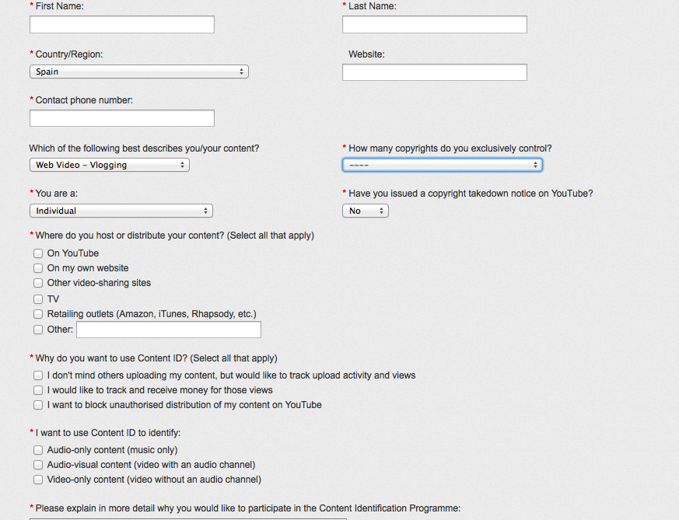
NO DUTY TO SUPERVISE
KNOWLEDGE
CONTROL
NO general duty to supervise
‘Advance knowledge’ – content management
© Teresa Rodríguez de las Heras Ballell

Slide 8
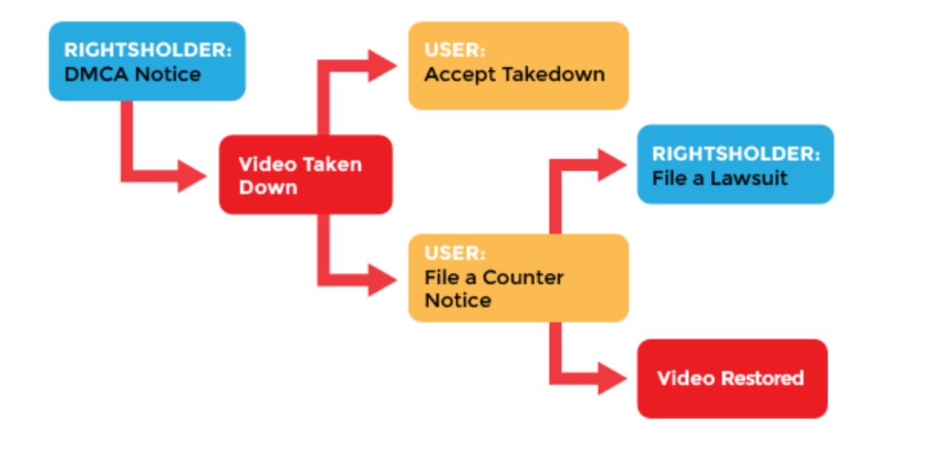
NO DUTY TO SUPERVISE
KNOWLEDGE
CONTROL
NO general duty to supervise
‘Advance knowledge’ – content management
Notice-based removal

Slide 9
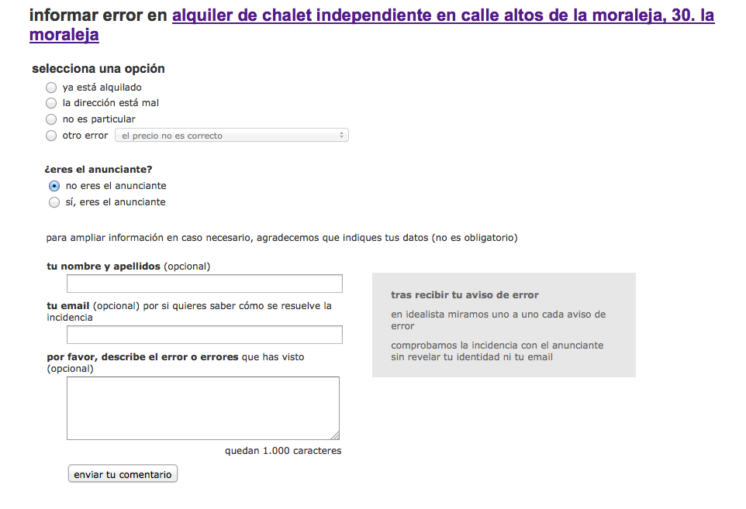

Slide 10
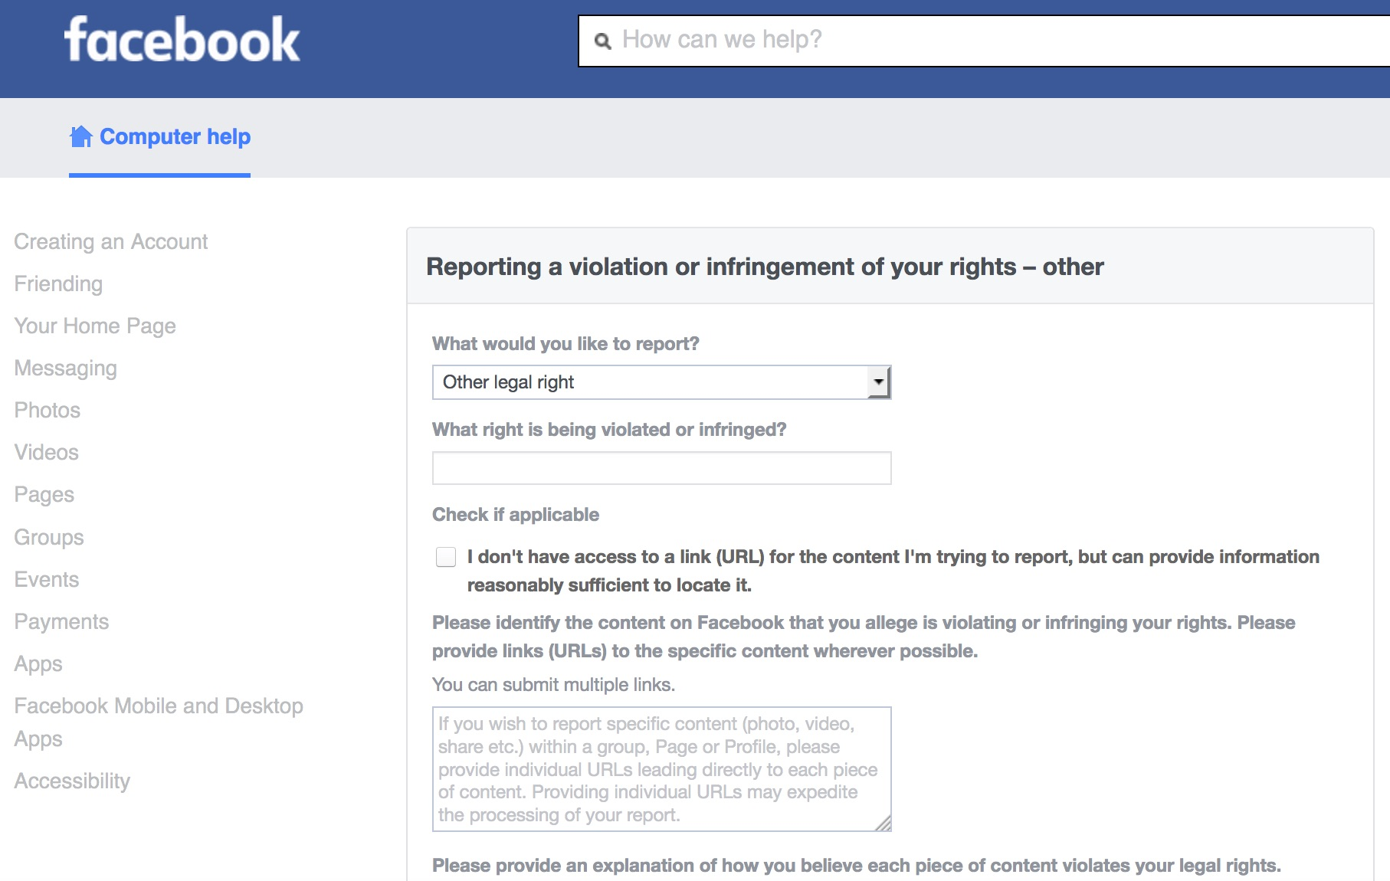

Slide 11
Key Issues to Consider for Harmonized Platform-Centered Rules
1). Legal concept of Platform
2). Roles of Platform Operator: regulate, supervise, enforce, dispute resolution
Active role

Slide 12
Are platform operators intermediary service providers?
ECJ 12 Jul. 2011, C-324/09: L’Oréal SA and Others v. eBay International AG and Others
Article 14(1) Directive on electronic commerce must be interpreted as applying to the operator of an online marketplace where that operator has not played an active role allowing it to have knowledge or control of the data stored’
Platform economy
ECJ 20 December 2017, C-434/15: Uber Spain Case // 2019 Airbnb
A). CONTROL / DECISIVE INFLUENCE
B). MARKET CREATOR
C). INTEGRAL PART
© Teresa Rodríguez de las Heras Ballell

Slide 13
Legal Anatomy of Platforms
Operator – Gatekeeper?
Membership Agreement (T&C)
User
Rules Book
Policies

Slide 14
1.- Obtaining knowledge
Voluntary measures
© Teresa Rodríguez de las Heras Ballell

Slide 15
2.- Decentralized supervision models
NOTICE AND TAKE DOWN SYSTEM
REPORT SYSTEM
COMMUNITY POLICY

Slide 16
3.- Orders
© Teresa Rodríguez de las Heras Ballell

Slide 17
Article 6(3)
Paragraph 1 shall not apply with respect to liability under consumer protection law of online platforms allowing consumers to conclude distance contracts with traders, where such an online platform presents the specific item of information or otherwise enables the specific transaction at issue in a way that would lead an average consumer to believe that the information, or the product or service that is the object of the transaction, is provided either by the online platform itself or by a recipient of the service who is acting under its authority or control.

Slide 18
Article 7 Good Samaritan provision
Providers of intermediary services shall not be deemed ineligible for the exemptions from liability referred to in Articles 4, 5 and 6 solely because they, in good faith and in a diligent manner, carry out voluntary own-initiative investigations into, or take other measures aimed at detecting, identifying and removing, or disabling access to, illegal content, or take the necessary measures to comply with the requirements of Union law and national law in compliance with Union law, including the requirements set out in this Regulation.

Slide 19
Findings and points for discussion
1). Granular, realistic, harmonized, and updated liability for online platforms
2). Mindful of platforms’ leading role in digital economy
3). Platforms as ‘private legal systems’
4). Incentives to implement voluntary measures as ‘fist-line enforcers’
5). Other proposals (ELI Model Rules) towards higher responsability/accountability/duties of the platform to the users
6). Scope, extent, and ‘expansive effect’ of Article 6(3) DSA

Slide 20
Teresa Rodríguez de las Heras Ballell
Professor of Commercial Law, Universidad Carlos III de Madrid
Academic Visitor, University of Cambridge
Member of the Expert Group to the EU Commission Observatory on Platform Economy
teresa.rodriguezdelasheras@uc3m.es

